Slide 1
Frontend Testing Introduction (Jest)

Slide 2
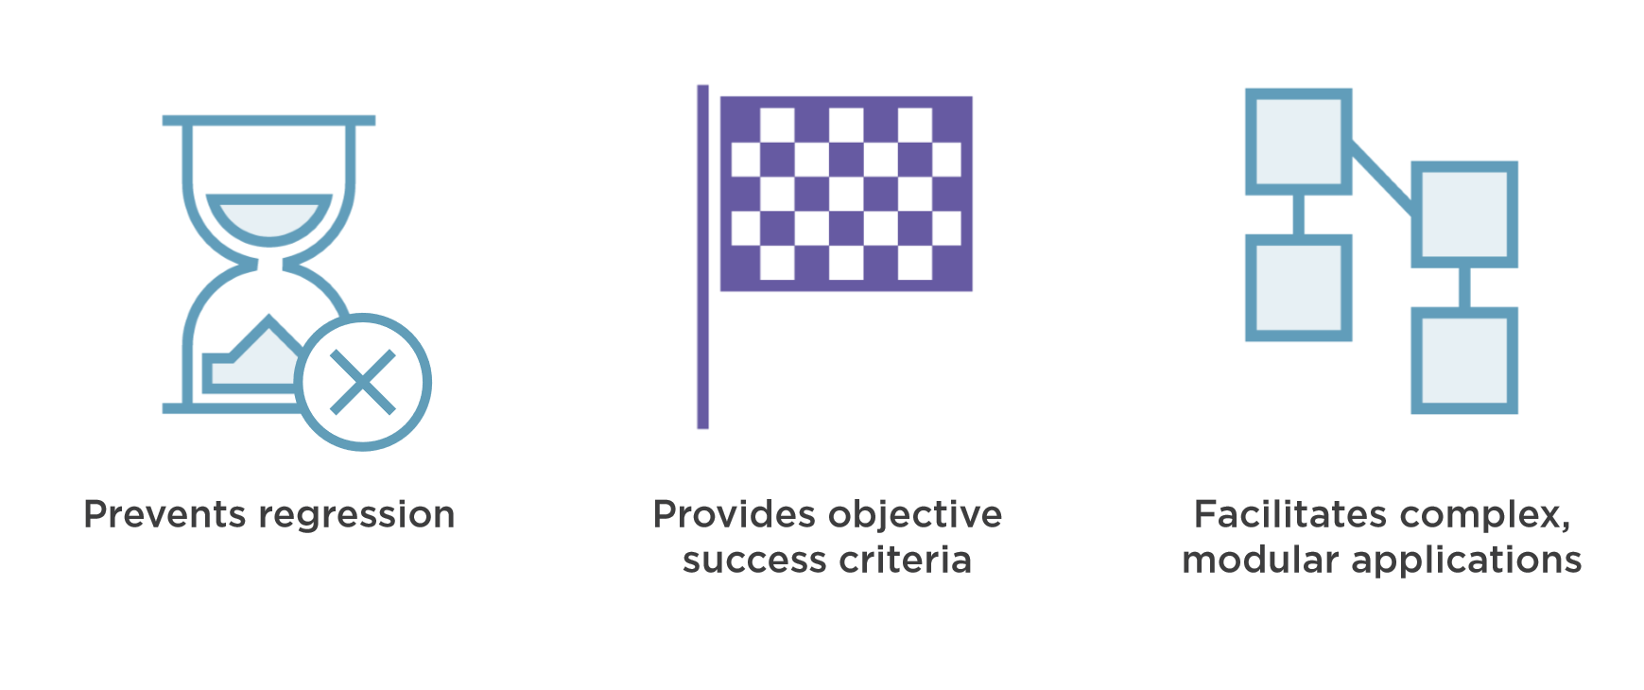
Why Testing?

Slide 3
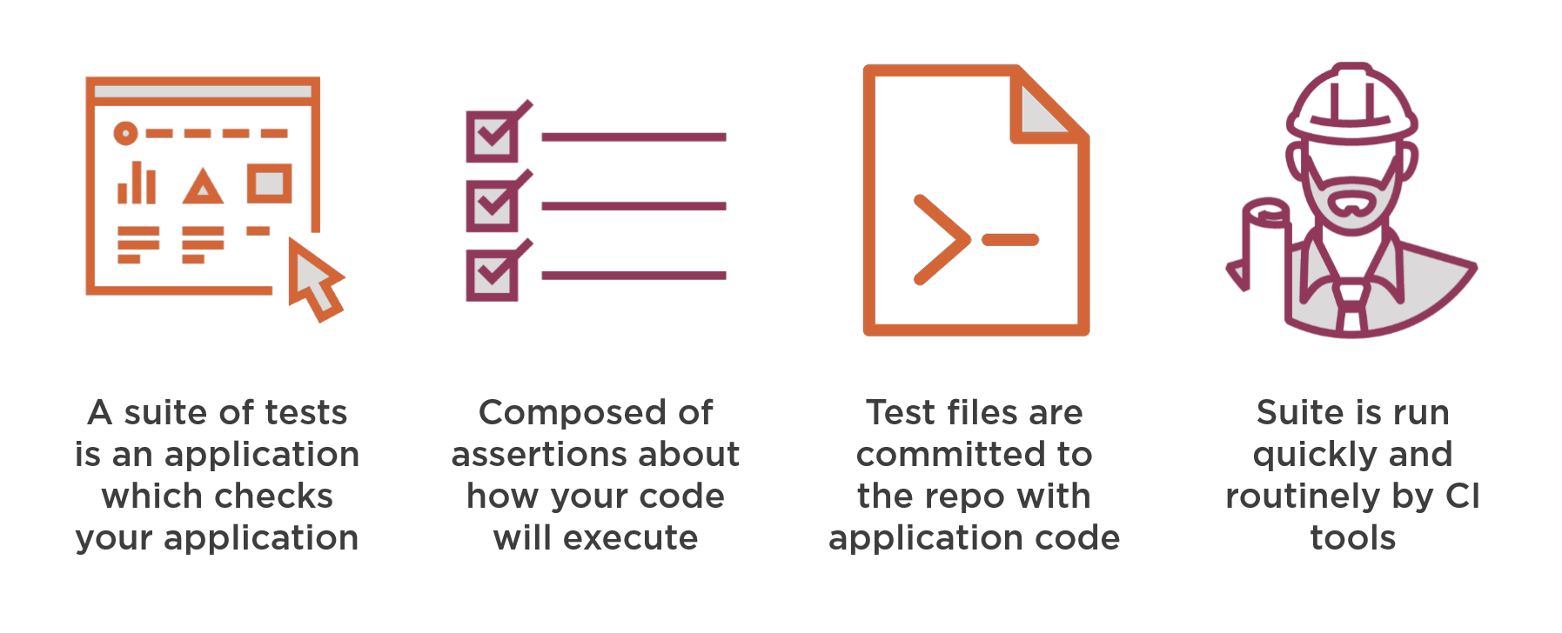
What Are Tests

Slide 4
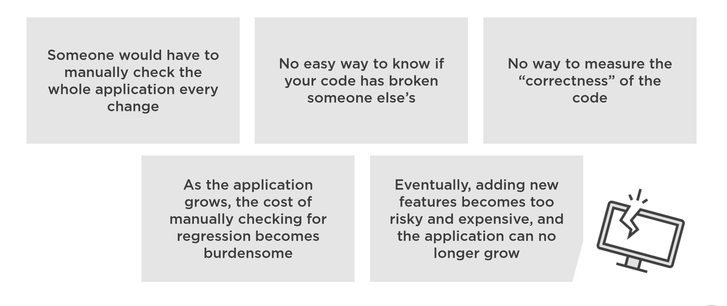
What if Tests Didn’t Exist?

Slide 5
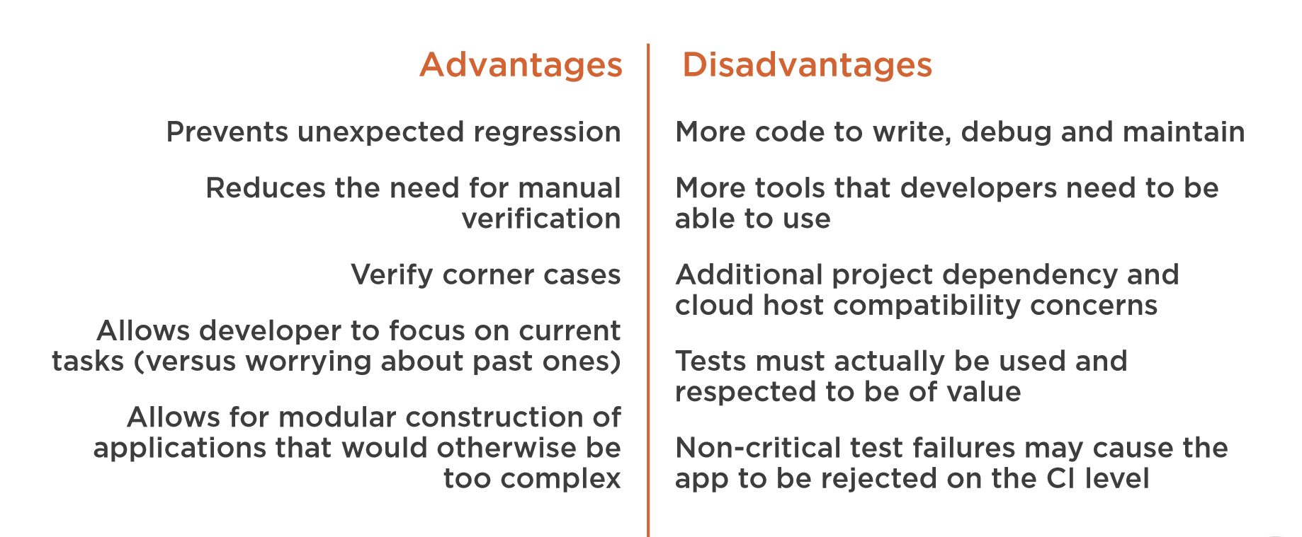
Advantages and Disadvantages of Testing

Slide 6
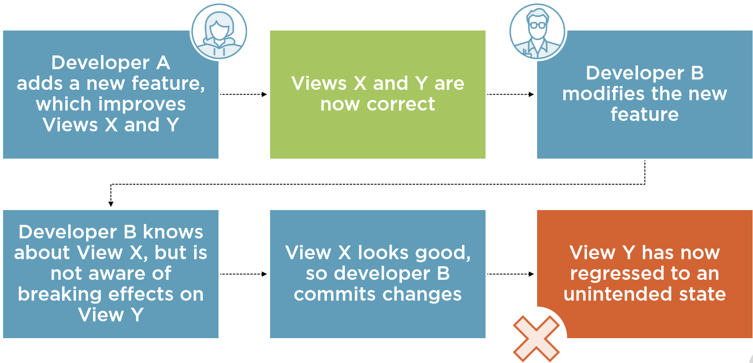
How Regression Works

Slide 7
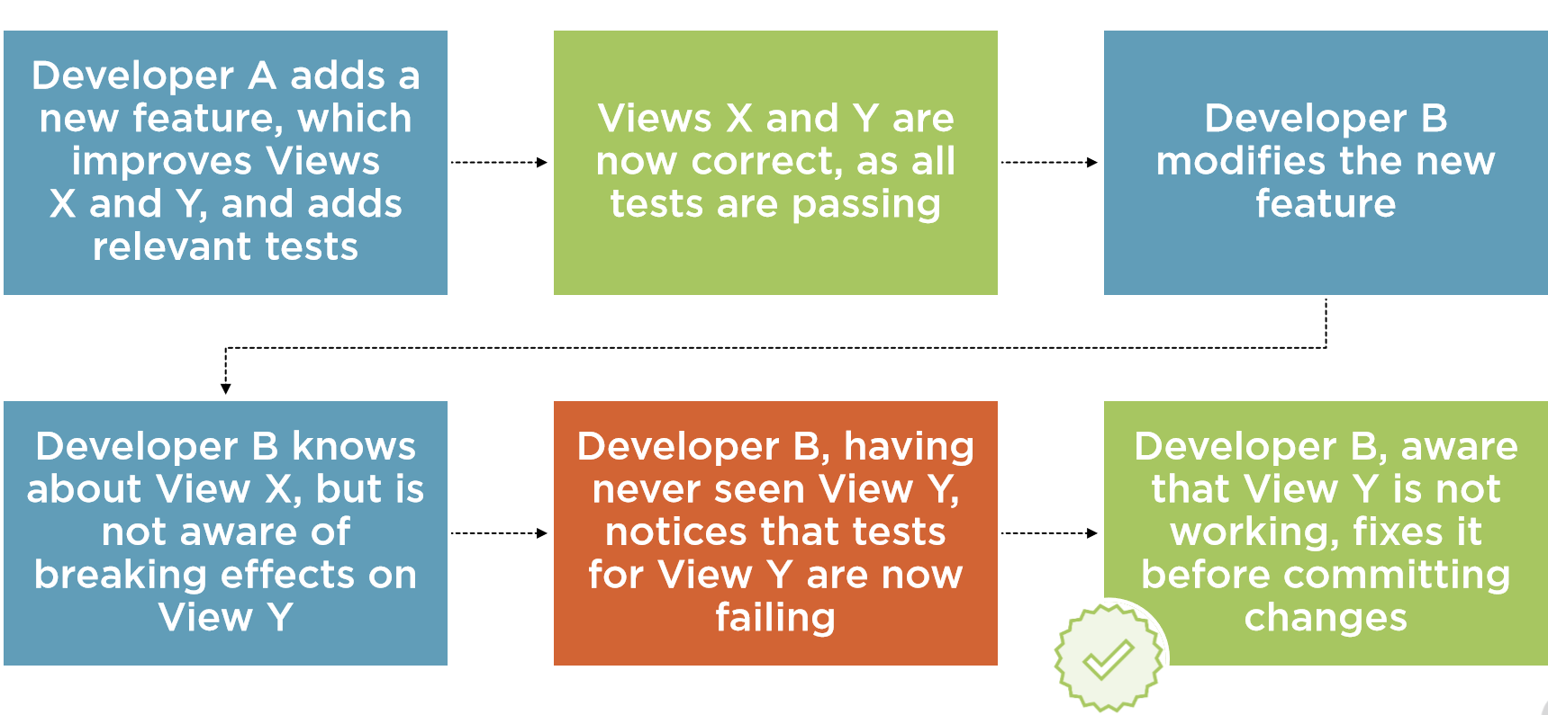
How Testing Stops Regression

Slide 8
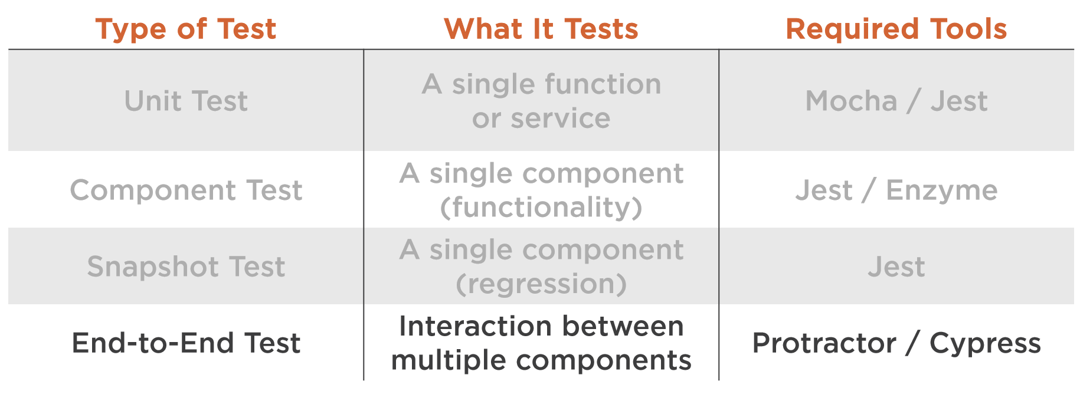
Different Kinds of Tests

Slide 9
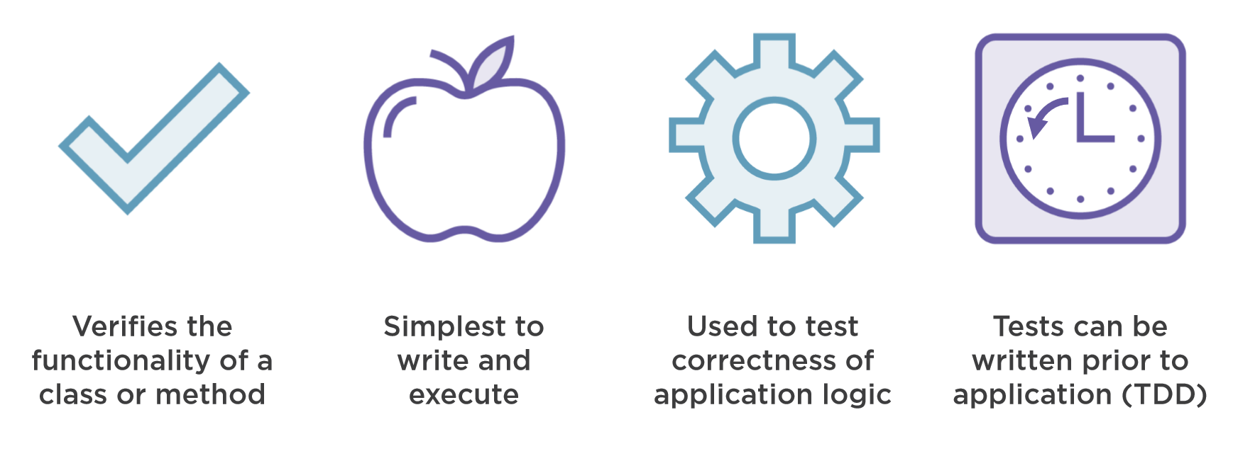
Unit Tests

Slide 10
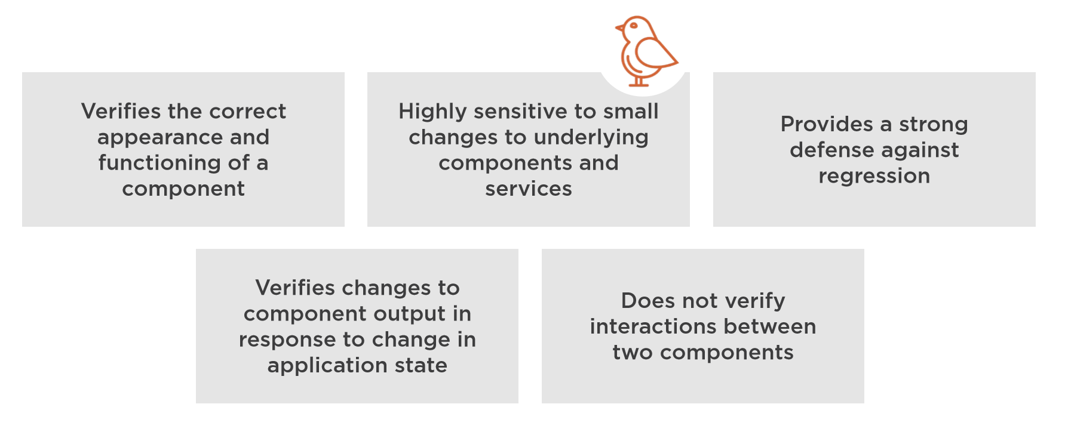
Component Tests

Slide 11
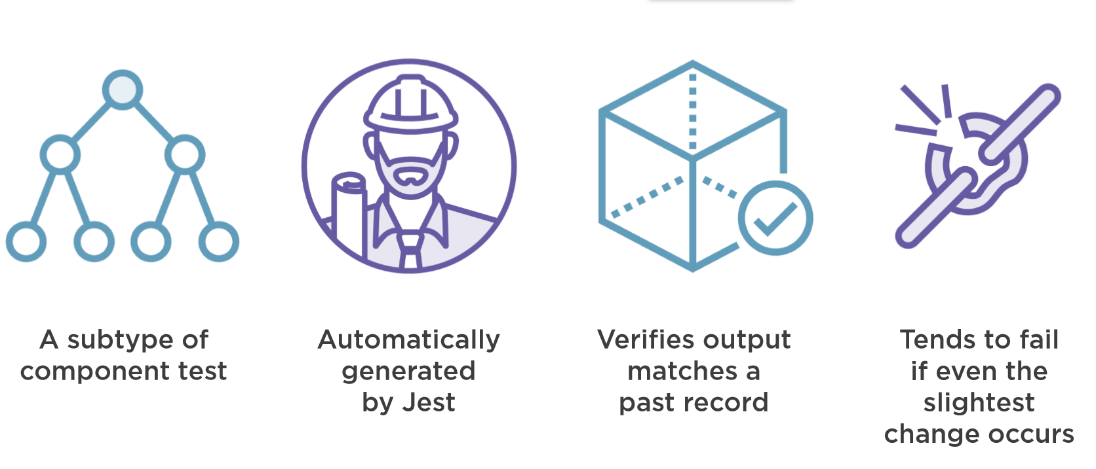
Snapshot Tests

Slide 12
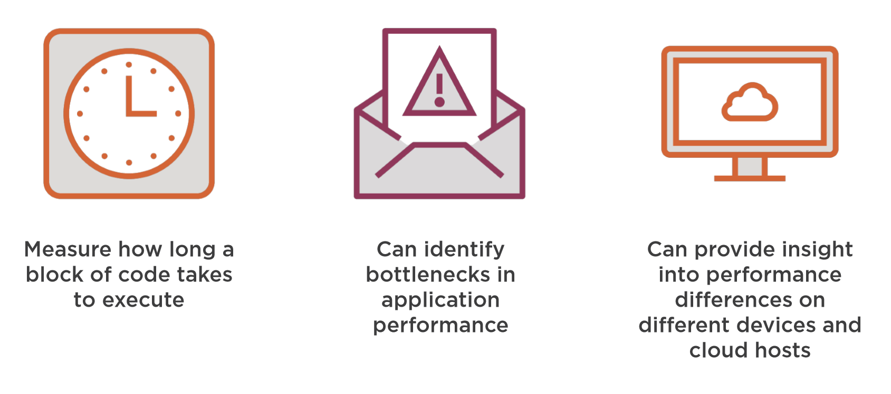
Performance Tests

Slide 13
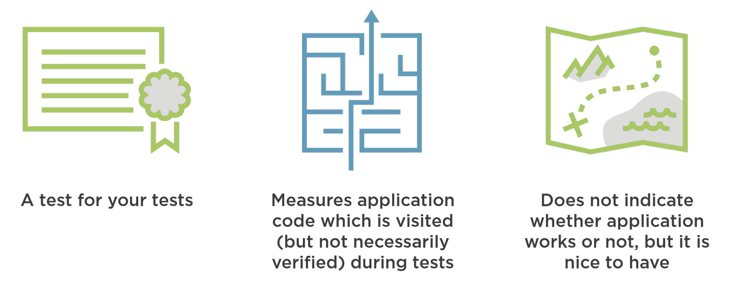
Coverage Tests

Slide 14
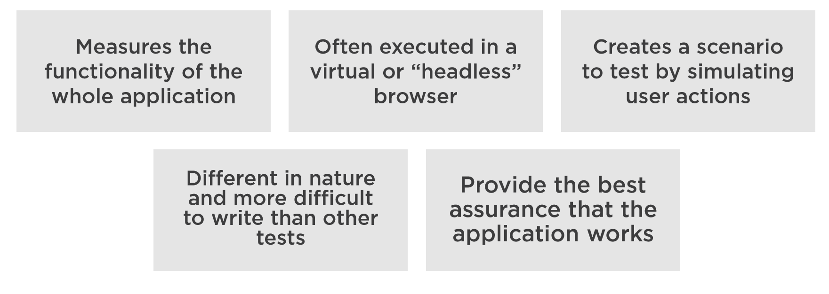
End-to-end Tests

Slide 15
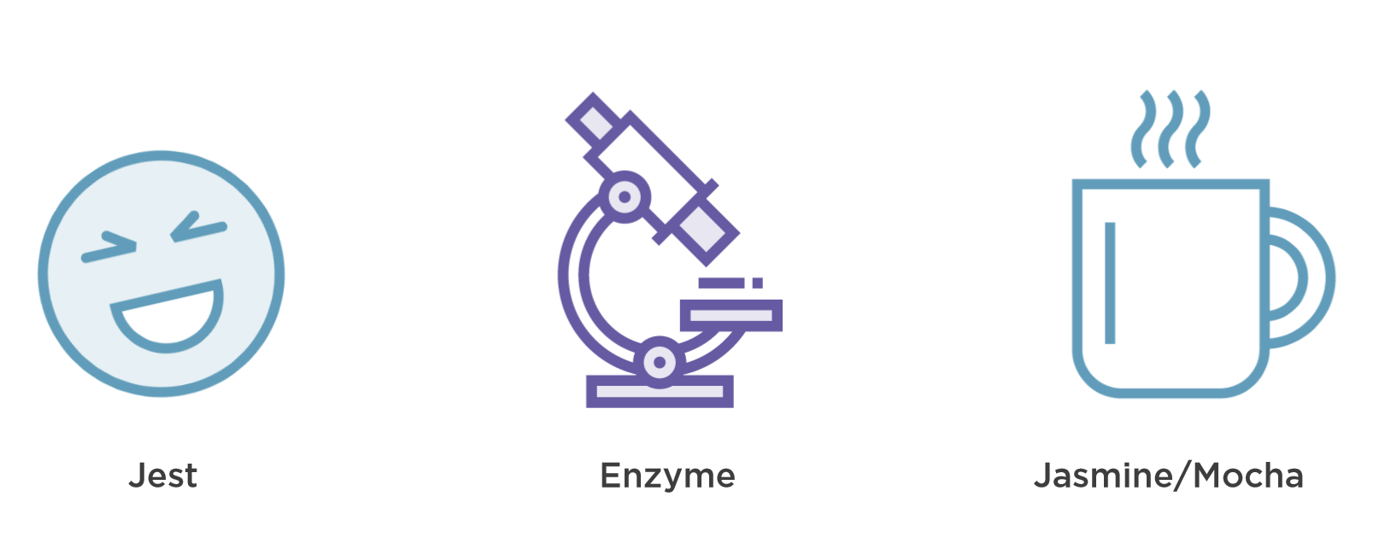
Testing Tools

Slide 16
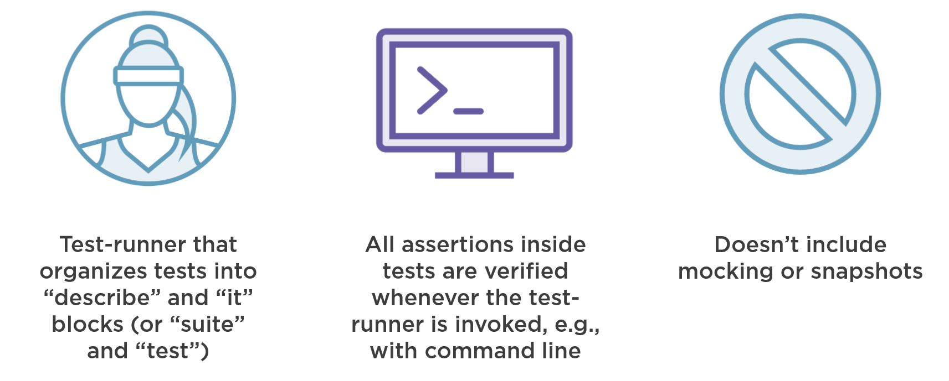
Jasmine/Mocha

Slide 17
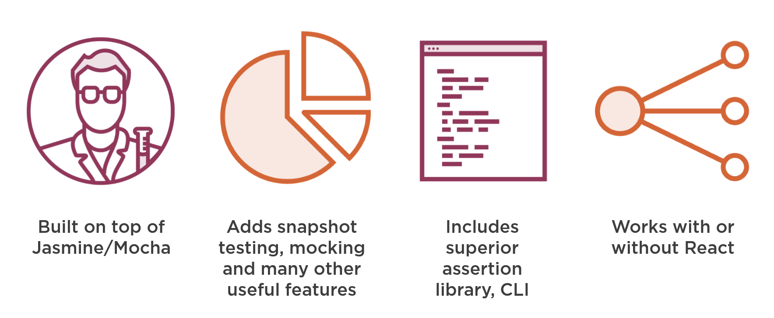
Jest

Slide 18
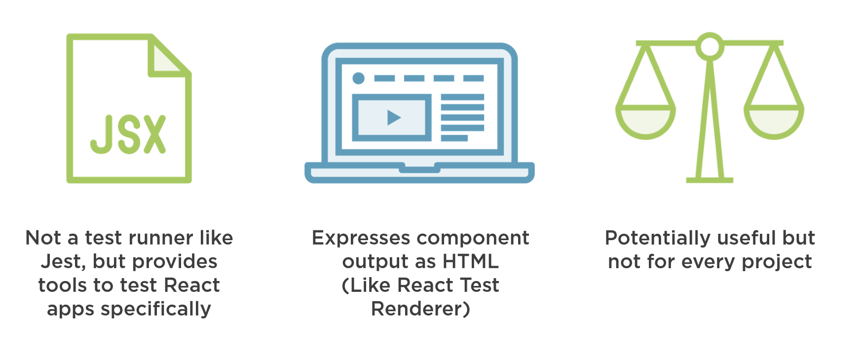
Enzyme

Slide 19
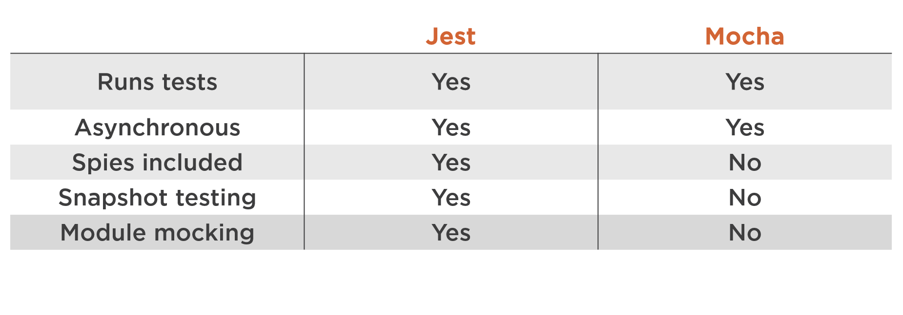
Jest vs. Mocha

Slide 20
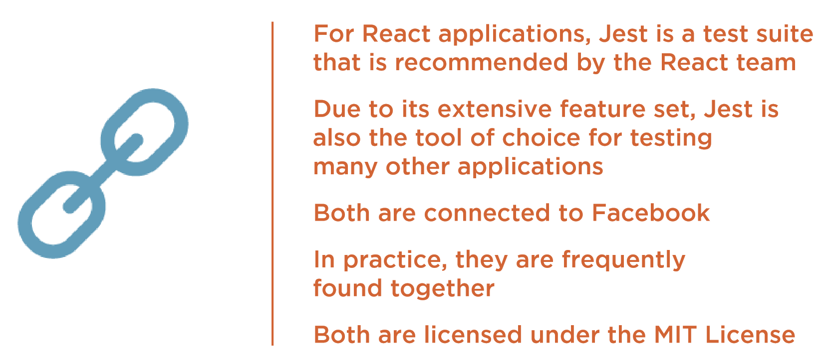
Jest and React – What’s the Connection?

Slide 21
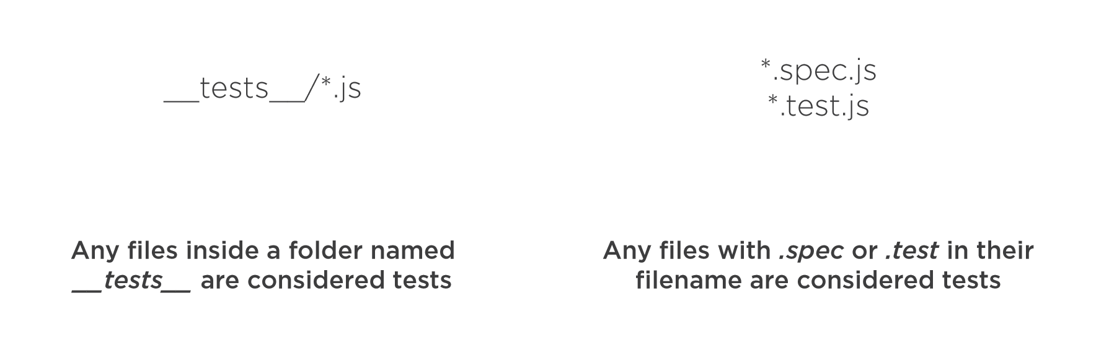
How Are Test Files Identified?

Slide 22
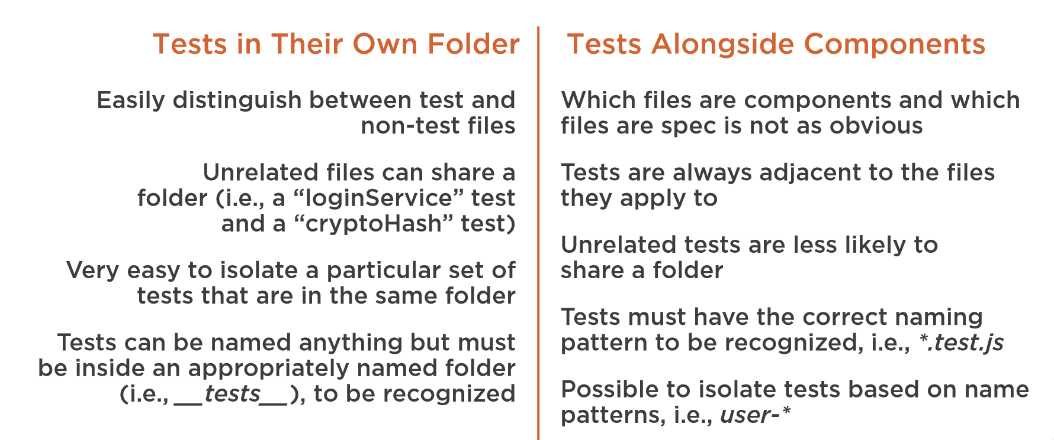
Should Tests Be Alongside Components or in Their Own Folder?

Slide 23
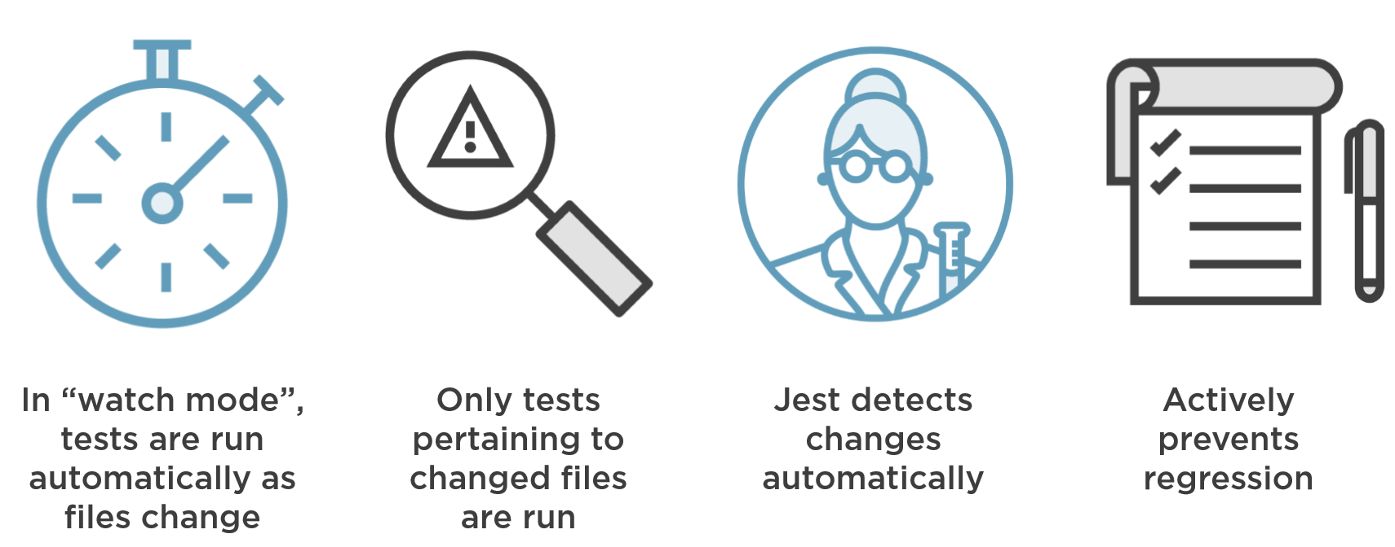
Watching Tests

Slide 24
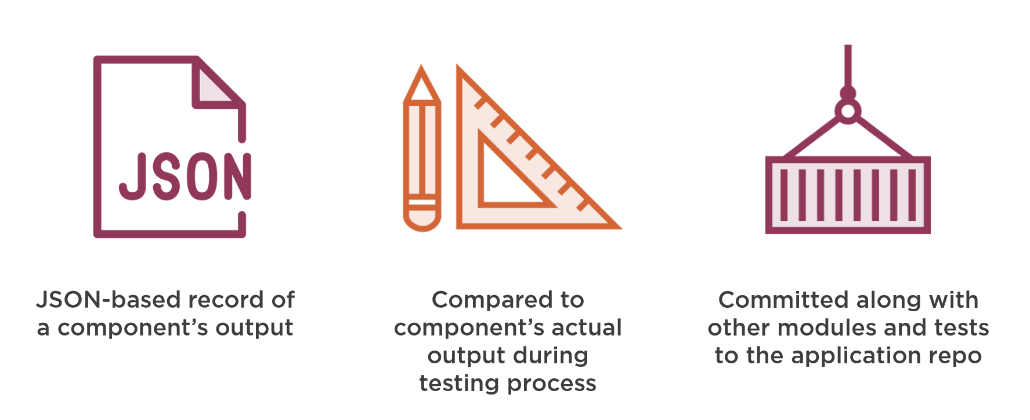
Snapshot Testing

Slide 25
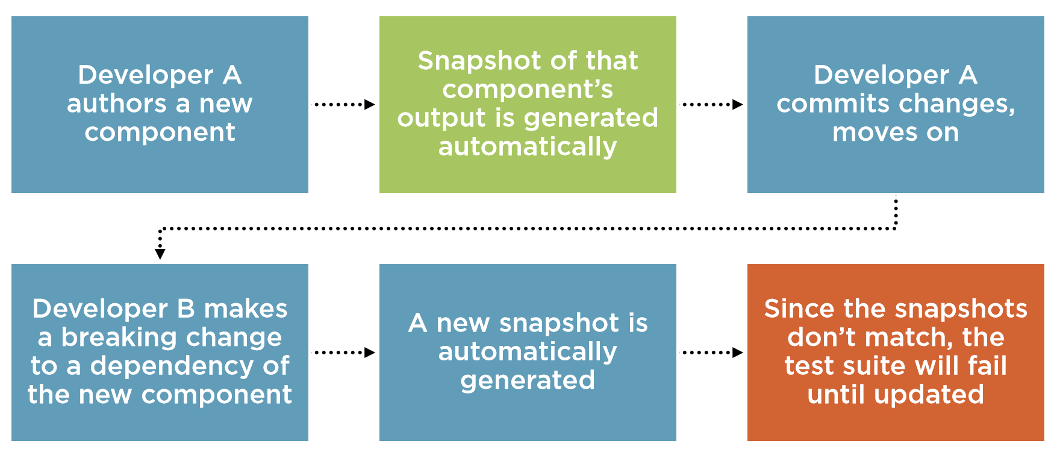
The Snapshot Testing Process

Slide 26
Thank you
Bran gu

